Slide 1

Capstone Project: Football Data Analysis
Name: <Pawan Singh>
Enrolment Number: <EN12025087161>
Batch Code: <5029>
Mentor: <Munna Pandey Sir>
Wave:<DA474AS47>

Slide 2
Business Objective
Problem Statement
The core objective is to harness extensive football data through advanced analytics to precisely assess player performance, streamline contract management, and enhance strategic decision-making for teams and referees. This involves overcoming challenges such as inconsistent data quality, the need for real-time adaptability, and the integration of qualitative insights. The ultimate goal is to generate actionable intelligence that supports effective scouting, match preparation, and business operations, thereby driving competitive success and improving overall operational efficiency
Player Performance
Event Analysis
Player Valuation And Regional Talent Analysis
Referee Analysis

Slide 3
Data Description
The dataset contains detailed records of football player appearances across multiple competitions and seasons.
Key player attributes include position, country of birth, height, market value, and contract details.
Match-specific data includes goals, assists, yellow/red cards, minutes played, and match outcomes.
The dataset captures team-level information such as home/away club names, stadium, attendance, and manager names.
Data spans various leagues, cups, and international competitions with a mix of categorical and numerical variables.

Slide 4
Tools and Techniques Used
Tools Used
Python Libraries: Primarily NumPy and pandas were used for data manipulation and analysis.
scikit-learn: Employed for machine learning models such as Simple Linear Regression and Multiple Linear Regression.
SQLAlchemy (MySQL with PyMySQL driver): Used to export processed data from pandas DataFrames to a MySQL database.
Excel (.xlsx): Data was imported and exported using Excel files, and pandas' read_excel and to_excel functions were frequently utilized.
Jupyter Notebook: Provided an interactive environment for development and documentation.

Slide 5
Insights
Player performance shows wide variation in goals and assists across different positions and competitions.
Forwards and attacking midfielders record the highest goal contribution, while defenders accumulate more fouls and cards.
Players with higher market values tend to have more playing time and better stats across key performance metrics.
Home teams generally score more goals and have better match outcomes than away teams, showing home advantage.
Higher attendance is correlated with important matches and popular teams, indicating fan influence on game ambiance.

Slide 6
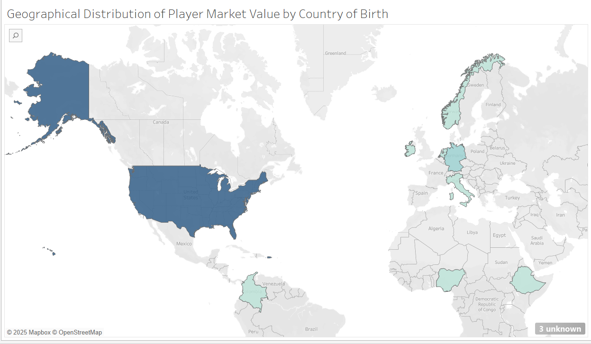
<<Talent Evaluation>>
OBSERVATIONS
The United States stands out with the highest total player market value among all countries represented on the map.
European countries like France, Sweden, and Poland also contribute significantly, indicating strong player market value distribution within Europe.

Slide 7
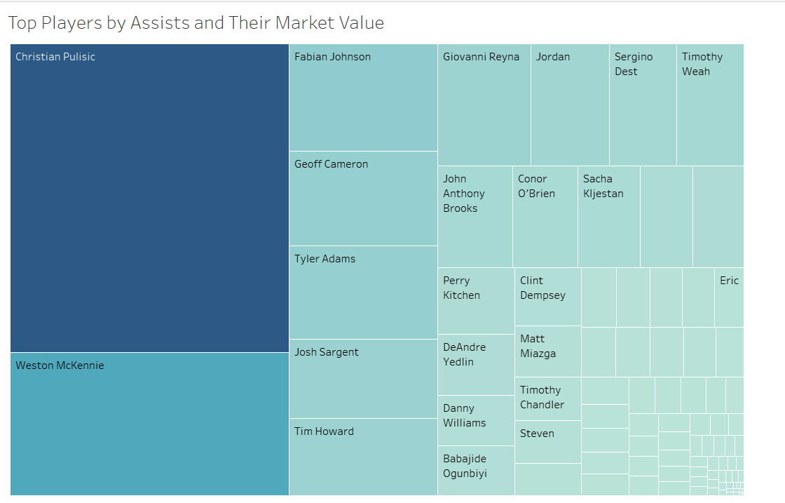
<<Talent Identification>>
Christian Pulisic leads in both assists and market value among all players shown.
Market value and assists are positively linked, as higher-assist players generally have greater market value.
Player Market Value Categories
High: Christian Pulisic
Medium: Weston McKennie, Fabian Johnson, Gio Reyna
Low: Players represented in the smallest rectangles, such as Babajide Ogunbiyi and others with smaller market value in the chart.

Slide 8
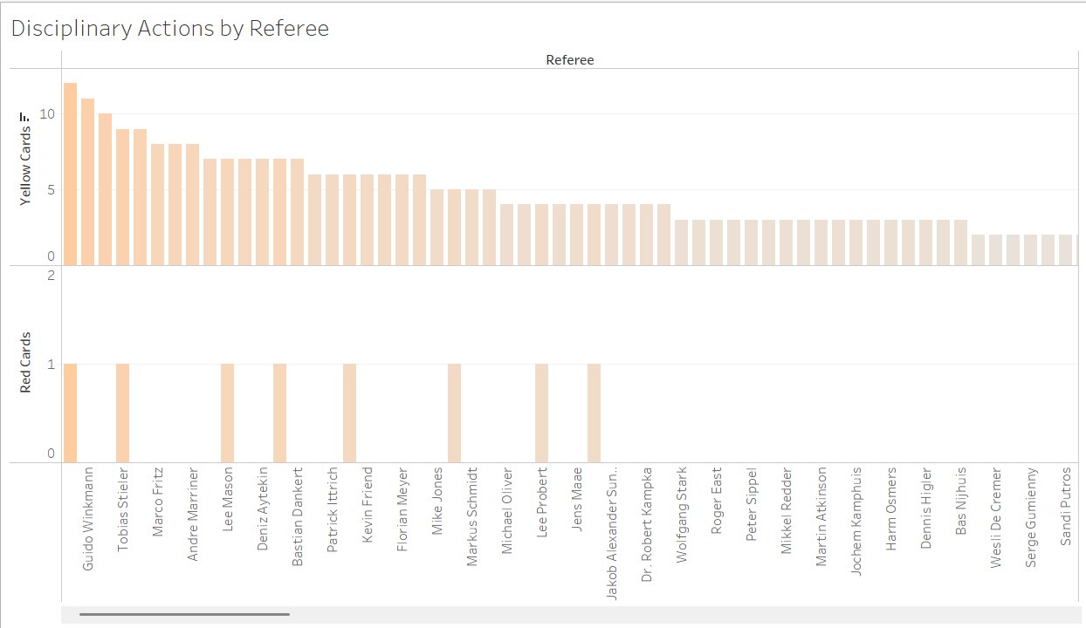
<<Decision Monitoring>>
OBSERVATIONS
Guido Winkmann has issued the highest number of disciplinary cards among referees, indicating a strict officiating style.
Most referees gave fewer red cards compared to yellow cards, showing greater use of cautionary warnings over expulsions.
Referee Card Distribution
High: Guido Winkmann
Medium: Referees such as Andre Marriner, Marco Fritz, Lee Mason
Low: Referees near the right of the chart, such as Sandi Putros, Serge Gumienny, Weis De Cremer

Slide 9
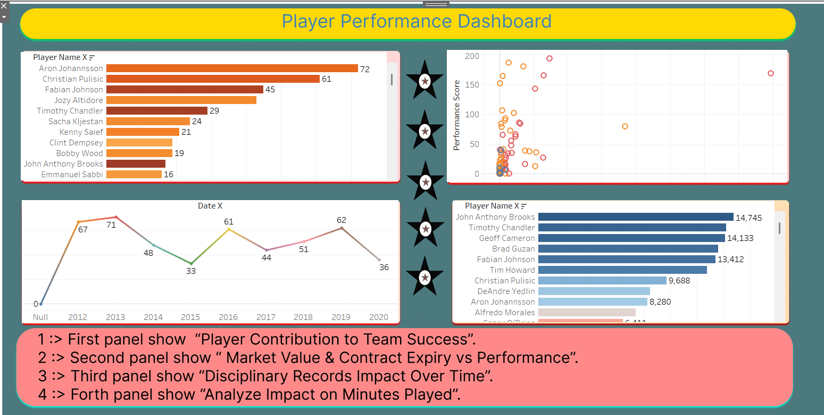
<< Performance Benchmarking >>
OBSERVATIONS
Aron Johannsson and Christian Pulisic have the highest contributions to team success based on goals scored.
Market value and contract expiry are visualized against individual performance, allowing identification of key players and contract considerations.
Disciplinary records fluctuate over the years, with peaks and drops highlighting changing patterns in on-field conduct.
Players with the most minutes played—John Anthony Brooks, Timothy Chandler, and Geoff Cameron—reflect strong consistency and reliability.
Player Market Value/Impact Categories
High: Aron Johannsson, Christian Pulisic (top left panel for goals and contributions)
Medium: Fabian Johnson, Jozy Altidore, Tim Howard, Brad Guzan (mid-sized indicators)
Low: Emmanuel Sabbi, Bobby Wood, Kenny Saief (lower range of goals/minutes played)

Slide 10
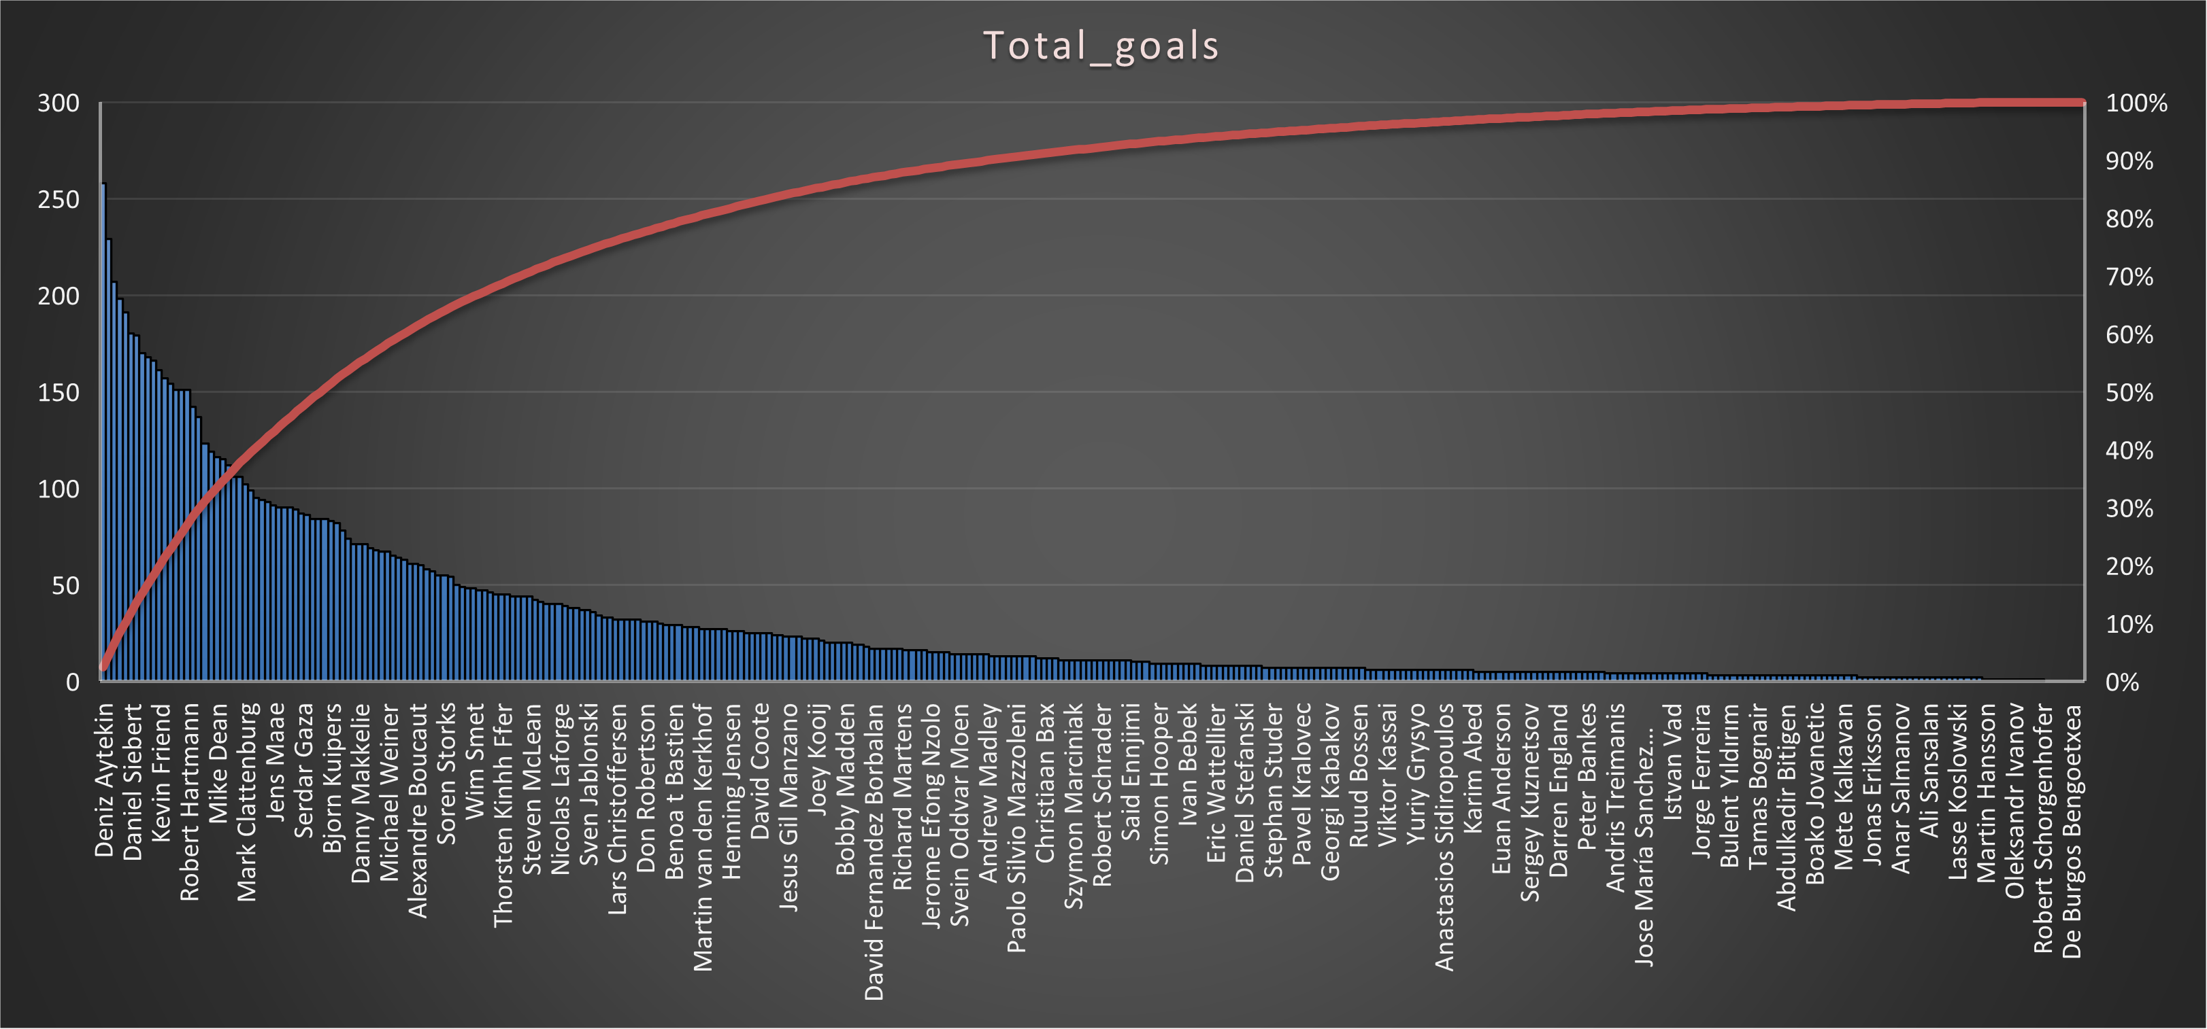
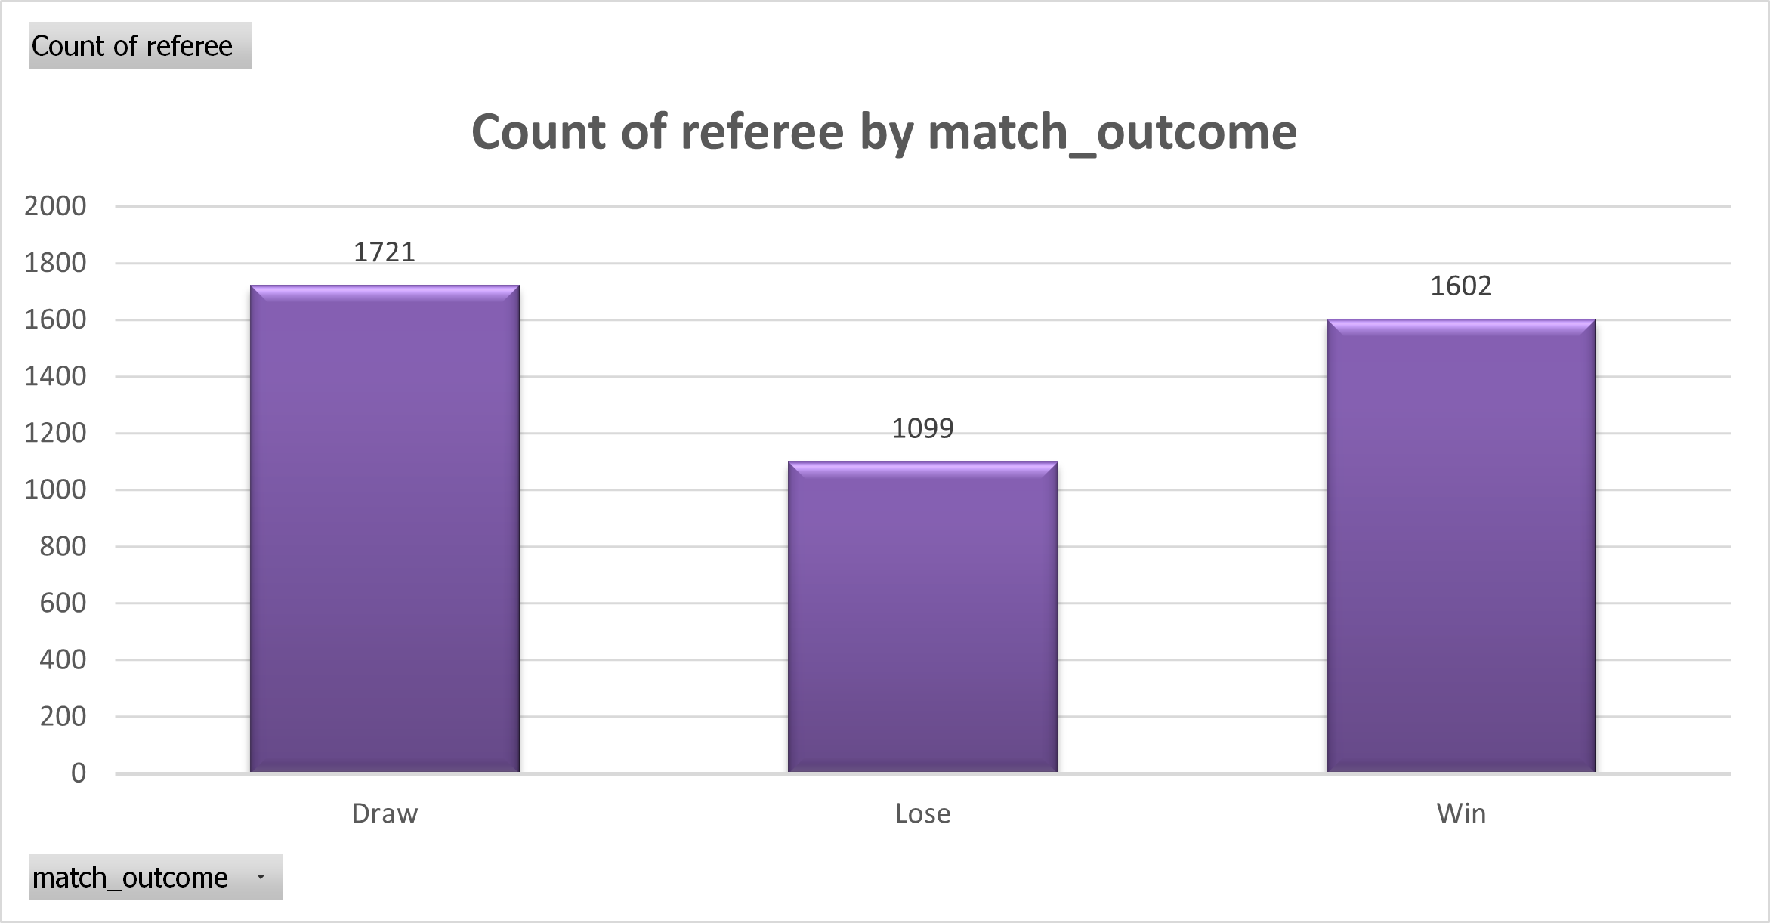
<<Referee Analysis>>
For Image 1: Total Goals Distribution
A small number of players score the majority of goals, shown by the steep initial drop in the bar heights (Pareto effect).
The cumulative goal percentage approaches 100% as more players are included, indicating goal concentration among top scorers.
For Image 2: Referee Count by Match Outcome
Referees oversee more matches ending in draws, followed closely by wins, with losses being the least frequent outcome.
There is a relatively balanced distribution of referees across different match outcomes.

Slide 11
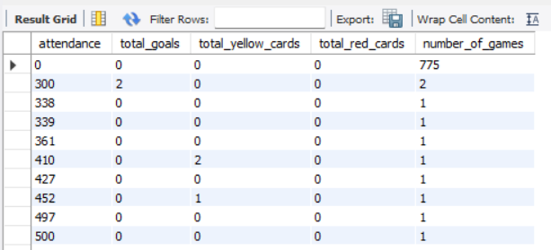
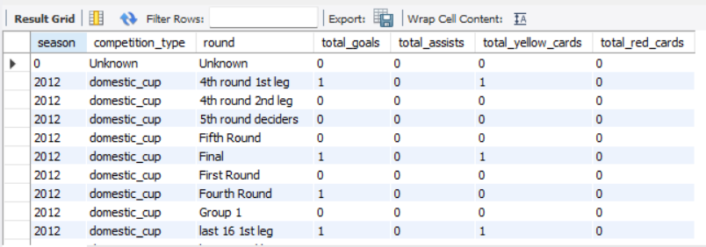
Relationship between attendance and events like goals or cards
MySQL
Attendance vs Events: This query examines how match attendance correlates with total goals, yellow cards, and red cards across games with different attendance figures. It helps understand whether larger crowds are associated with more scoring or disciplinary actions.
Trends in frequency of goals, assists, and cards over seasons, competition types, or rounds
Trends Over Seasons and Competitions: This query analyzes how the total counts of goals, assists, and cards vary by season, competition type, and round. It shows patterns and fluctuations in these key events over time and competition stages.

Slide 12
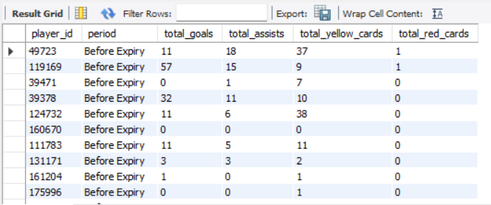
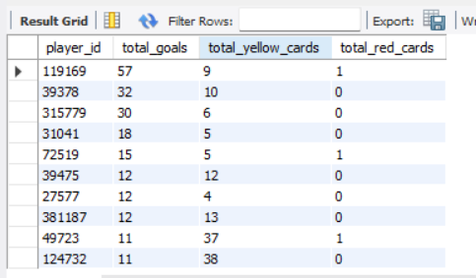
MySQL
Player events before and after contract expiration
Player Events Before and After Contract Expiration: This query compares player performance metrics (goals, assists, cards) in periods before and after their contracts expired, highlighting how player contributions might change around contract status.
Impact top ten player on goals or cards in a match
Top 10 Players' Impact: It identifies the top ten players ranked by goals scored, and summarizes their goals, yellow cards, and red cards to assess their overall match influence.

Slide 13
Business Implementation of <<Model 1: Linear Regression>> Model
COEFFICIENTS: [0.00120952]
INTERCEPT: 0.010922618870422299
R^2 SCORE: 0.009553344782025852
MSE: 0.08011748484042154
RMSE: 0.2830503220991305
MAE: 0.13963282979231592

Slide 14
Summary
The project analyzes extensive football data to assess player performance, contract management, and match events using Python, SQL, and machine learning techniques.
Key insights reveal performance variations by position, match outcomes influenced by home advantage, and correlations between market value and player contributions.
Talent evaluation highlights regional player market trends, with top performers like Christian Pulisic leading in assists and market value.
Referee analysis shows disciplinary patterns and match oversight distribution.
Predictive modeling was applied, though with moderate accuracy, to inform player valuation and strategic decisions.

Slide 15
Conclusion
Data limitations and quality issues may impact analysis accuracy and broader applicability.
Analytical models might not capture all influencing factors, suggesting limitations in prediction depth.
Resource constraints restricted project scope, affecting experimentation and optimization.
Future work can enhance data integration with real-time feeds and apply advanced machine learning for deeper insights.
Expanding the study to other regions and larger datasets can validate and extend the methodology's applicability.

Slide 16
Limitation and Future Scope
Limitations
Data Constraints: The analysis might be limited by the quality and completeness of the dataset, which can affect the accuracy and generalizability of the results.
Model Limitations: The choice of models or analytical techniques may not capture all complexities or external factors influencing the subject, limiting prediction or insight depth.
Resource and Time Limits: Constraints in computational resources or project duration can restrict the extent of experimentation and optimization possible.
Future Scope
Enhanced Data Integration: Future work can incorporate additional data sources and real-time data feeds to improve model robustness and applicability.
Advanced Analytics: Implementation of more sophisticated machine learning or deep learning techniques could uncover deeper insights and improve prediction accuracy.
Broader Application: Extending the methodology to different domains, geographic regions, or larger datasets could validate and expand the utility of the findings.

Slide 17

THANK YOU

